Slide 1
Image Classification

Slide 2
Group Members
F16CS06
F16CS18
F16CS72

Slide 3
Contents
Abstract
Introduction
Problem Statement
Problem Solution
Aim
Technologies Used
Methodology

Slide 4
Abstract
Image classification has been so far carried out almost exclusively using sophisticated and expensive software solutions and devices. Mobile devices have evolved to the extent that they can be used for such purpose, but the algorithms and systems that provide such functionalities in real time are rare. We will show the theoretical basis of the image classification, implementation of the algorithm using the android studio and google libraries and the practical experience in such an approach.

Slide 5
Introduction
Image Classification is a complex process
It refers to extracting classes from a multiband raster image.

Slide 6
Problem Statement
We see different things everyday that we come across for the first time. And we know the thing by its name the second time we see that. But what would happen if you don’t have to wait for the 2nd time? Using Image Classification, we can use our android device’ camera to ensure that we have the correct name of every objects at once we see the object.

Slide 7
Solution
There is certain many different application available on Play Store, all waiting to be downloaded and be used. But the main drawback of these application is that they need very high-speed internet support in order to get the data from their servers.
This problem gives birth to delay in catching and integrating the information for a useful purpose. Plus, in countries, like ours, we do not have stable and high-speed internet connection all the time, therefore, such application, that are already available in the market, are not feasible to be used by local users.

Slide 8
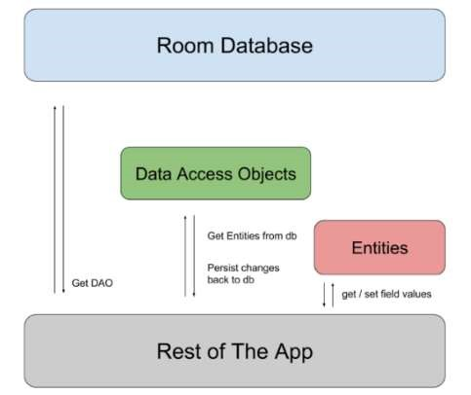
Aim
We aim to use, Android’s ORM database, along with Firebase Machine Learning Libraries, integrated with a preplanned and pre-trained Machine Learning App that would allow our database to use many algorithms and implement them in our image classification app

Slide 9




Technologies Used

Slide 10
Algorithm Used
Faster R-CNN
YOLO
SSD
Notes:
Faster R-CNN - Region CNN ( Conventional Neural Network)
YOLO – You only look once
SSD - Single Shot MultiBox Detector

Slide 11
Libraries Used
Google ML Kit
Firebase Optical Engine
Android Firebase Dependencies
Android Object-Related Mapping Database
Google Face Detection API

Slide 12
Methodology
Data Captured by Camera
Data sent to ORM Database
ORM Checks within its records
Returns the result to Firebase ML Framework
Result sorted and sent to Java and XML code for output
Data shown on the screen

Slide 13

Outcome

Slide 14
Thank You

